Slide 1
Group 13
Heidi Falcon, George Flude, Macaulay Mills

Slide 2
Logline
Players aim to grow by eating bubbles while avoiding hazards and obstacles, and the first to eat their opponent, wins.

Slide 3
Target Audience
16-25 either gender
Short gameplay
10 Seconds

Slide 4
Mechanics
Character Movement
Keyboard
Controllers
Tablet/Mobile
Power ups
Eating/Absorbing
Hazards
Inhibitor
Strength diminished
Obstacles
Branches

Slide 5
Physics
Buoyancy
Everything has a weight as in water
Floats as in water
Sinks as in water

Slide 6
Emotion
Competitiveness
Aggression
Struggle
Frustration
Resentment

Slide 7
Game Specifics
Bragging Rights
Limited supply of items
Race to claim the item
Conflict
Players can bump the characters and obstacles

Slide 8
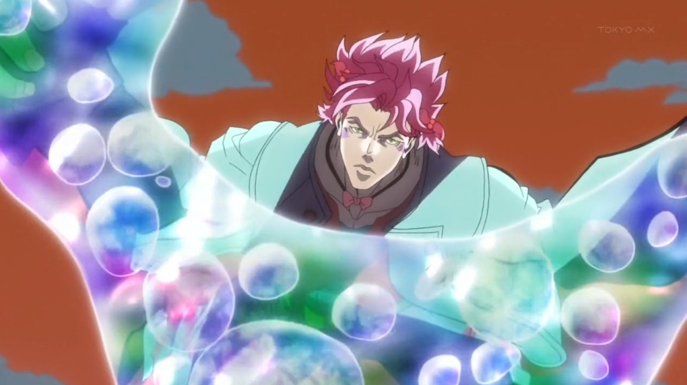

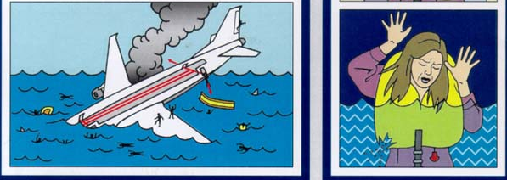
Theme
Bubbles
Solid Colours

Slide 9
Prototype

Slide 10
What needs to be done next
Finalise Art Style
Assurances/Feedback
Prototype rest of mechanics for concepts
Decide on Platform
Sounds
Assurances/Feedback

Slide 11
Questions?

